Slide 1
Professional Development Opportunities

Slide 2
Data Sources
Three data sources were considered for this presentation:
Employee Survey to Determine Desirability of Professional Development
Cost of Professional Development per Employee for various lengths
Employee Survey to Determine Professional Development delivery preference

Slide 3
Data: Desirability Survey
Either Ordinal (item level) or Interval Data (total)
Survey deployed to 50 participants
Score determined by totaling 10 item scores on survey
For each item, participants could add between 1 and 7 point to their score total (Ranging from Strongly Disagree to Strongly Agree)
Maximum score: 70, Minimum Score: 10
Higher scores suggest professional development is more desired

Slide 4
Data: Professional Development Cost
Ratio Data
Costs collected from vendor for hourly rate per employee
Collected multiple rates for varying total hours of professional development

Slide 5
Data: Delivery Preference Survey
Nominal or Categorical Data
Surveyed 50 participants – Managers and Employees
Asked for Mode of Delivery: Online, In Person, or Hybrid
Asked for Method of Delivery: Synchronous or asynchronous

Slide 6
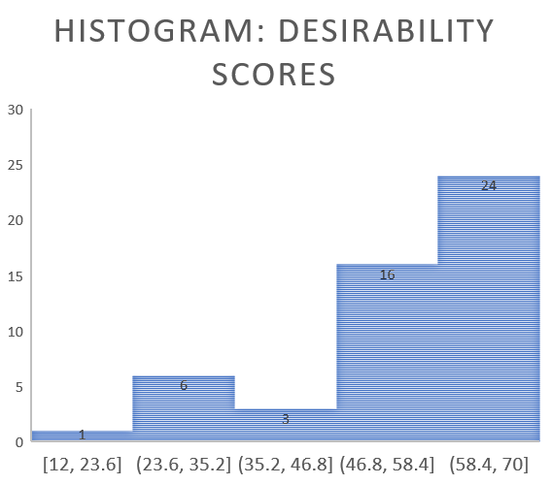
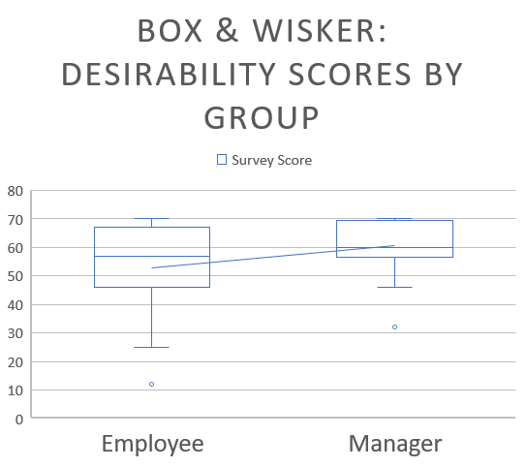
Visual Representation: Desirability Survey

Slide 7
Visual Representation: Cost

Slide 8
Visual Representation: Delivery Preference

Slide 9
Desirability Statistical Analysis: Descriptive
Population (N) | Mean (95% CI) | Median | Mode | Standard Deviation
Managers (21) | 60.52 (4.23) | 60 | 70 | 9.28
Employees (29) | 52.79 (5.90) | 57 | 68 | 15.52

